Slide 1
WELCOME
to the ROMANIAN NATIONAL ENFORCEMENT BODY
RO NEB – rail passengers rights

Slide 2
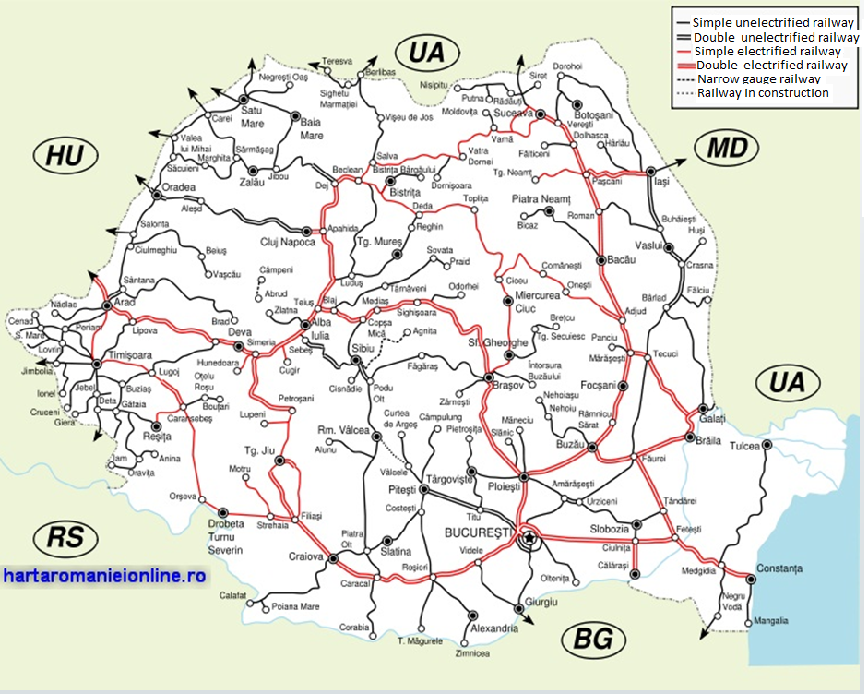
Romania's railway network
The interoperable railway infrastructure is managed in accordance with the provisions of railway operators free access and developed in accordance with the European technical regulations for interoperability.
The interoperable railway infrastructure is currently connected to the European rail network through the railway infrastructure managers of neighboring countries: Hungary (MAV), Serbia (ZS), Bulgaria (NRIC), Moldova (CFM) and Ukraine (UZ).

Slide 3
In Romania the following railway entities carry out their activity: one railway public infrastructure administrator CN CF CFR SA 4 railway uninteroperable infrastructure managers: SC TRANSFEROVIAR GRUP SA SC RC-CF TRANS SRL SC VIA TERRA SPEDITION SRL SC APRIA SRL
One national railway passenger undertakings: SNTFC SA – ( CFR Passengers)
5 railway passenger undertakings SC REGIO Passengers SRL
SC TRANSFEROVIAR PASSENGERS SRL
SC INTERREGIONAL PASSENGERS SRL
SC SOFTTRANS SRL
SC ASTRA TRANS CARPATIC SRL

Slide 4
Situation of railway tracks management
613 km
Unexploited railway tracks
Public infrastructure manager
CN CF CFR SA
Railway infrastructure uninteroperable managers:
TRANSFEROVIAR GRUP
RC-CF TRANS
VIA TERRA SPEDITION
APRIA
86,7 km
1241,4 km
956 stations
RO NEB -rail pax rights

Slide 5
Situation of railway tracks management
1-1,5%
1%
3,5-5%
1%
National railway passengers undertaking
CFR Passengers
Railway passengers undertakings
SC REGIO PASSENGERS SRL
SC TRANSFEROVIAR PASSENGERS SRL
SC INTERREGIONAL PASSENGERS SRL
SC SOFTTRANS SRL
SC ASTRA TRANS CARPATIC SRL
10 -15%
76,5-86 %
67.104.000 passengers
in 2018
RO NEB -rail pax rights

Slide 6
DEROGATIONS ACCORDING TO THE REGULATION (EC) 1371/2007
In Romania derogations from REGULATION (EC) 1371/2007 on rail passengers’ rights and obligations are as follows:
for domestic rail services: all the provisions of the Regulations, except as provided in Article 2 (3), until December 3, 2019;
for urban, suburban and regional: all the provisions of the Regulations, except as provided in Article 2 (3) until December 3, 2019;
for international rail services beyond external EU borders: all the provisions of the Regulations, except as provided in Article 2 (3) until December 3, 2019;
RO NEB -rail pax rights

Slide 7
Presentation of the Romanian Railway Authority - AFER
General Manager
Deputy Technical General Manager
Passengers Rights Surveillance Service (RO NEB)
RO NEB -rail pax rights

Slide 8
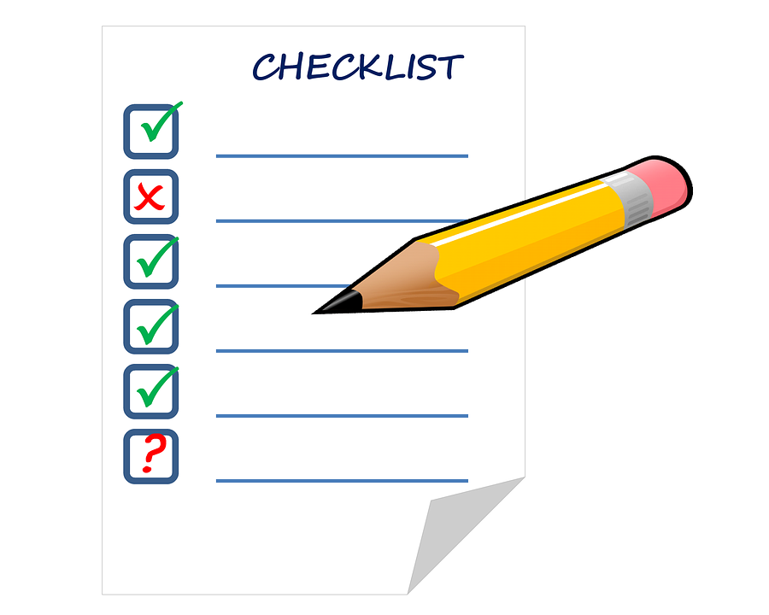
Tasks Passengers Rights Surveillance Service (RO NEB)
In accordance with Art. 4 (2) of the Regulation on the organization and functioning of the Romanian Railway Authority - AFER, which constitutes Annex no. 1 to Government Decision no. 626/1998 for the establishment of the Romanian Railway Authority - AFER, and with art. 30 (1) of the Regulation of functioning of the Romanian Railway Authority - AFER, the Passenger Rights Surveillance Service have the following tasks to verify the activity of the railway passenger transport operators, the railway infrastructure managers and the public railway infrastructure manager:
verification throughobservance of the internal and international regulations regarding the rights and obligations of the passengers in the railway transport and mainly of the REGULATION (EC) No 1371/2007 of the European Parliament and of the Council of 23 October 2007 on rail passengers rights and obligations;
verification of the implementation stage of the provisions of the REGULATION (EC) No 1371/2007 of the European Parliament and of the Council of 23 October 2007 on rail passengers rights and obligations
analyze and settle the complaints of Romanian and foreign natural and legal persons regarding the rights and obligations of passengers in the railway transport.
In order to accomplish the object of activity, the Travel Rights Surveillance Service establishes at the beginning of the year the objectives it pursues on the basis of the topic approved by AFER management.
In this respect, we present the proposed topic for carrying out the activity of supervising the observance of the REGULATION (EC) No 1371/2007 on the rights and obligations of rail passengers used in 2018 separately for the infrastructure manager and the rail passenger transport operators.
RO NEB -rail pax rights

Slide 9
The topic of the supervision action of the railway passenger transport operators regarding compliance with the provisions of Regulation (EC) No 1371 for 2018
Verifying how railway undertakings allow travelers to bring their bikes on board the train if they are easy to handle, if they do not adversely affect the rail transport service and if the rolling stock used so permits, for a cost, as the case may be (Article 5).
Verification of the manner in which railway undertakings and ticket vendors offering transport contracts on behalf of one or more railway undertakings provide passengers on request with at least the information listed in Annex II, Part I, on the journeys for which the contract of carriage is offered by the railway undertaking in question (Article 8 (1)).
Verification of the manner in which railway undertakings provide passengers with travel information at least with the information listed in Annex II, Part II (Article 8 (2) and (3)).
Verification of the obligation of railway undertakings and ticket vendors to provide transport tickets, direct tickets and reservations (Article 9) to the extent of their availability.
Verifying that railway undertakings and ticket vendors use the computerized information and reservation system for rail transport (Article 10).
Verifying how railway undertakings are responsible for delays, loss of linkage and cancellation (Article 15, Annex I , Title IV, Chapter II).
Verifying that railway undertakings reimburse travelers for the cost of transport tickets or redirect travelers arriving at their final destination with a delay of more than 60 minutes (Articles 16 and 17).
Verification of compliance with the provisions on the right of transport for disabled persons and persons with reduced mobility (Article 19).
Verification of compliance with the provisions on the provision of information to disabled persons and persons with reduced mobility on the accessibility of railway services and the conditions for access to rolling stock and on facilities offered on board (Article 20 (1)).
Verifying that railway undertakings ensure that rolling stock is accessible to disabled persons and reduced mobility (Article 21) by complying with the TSI for persons with reduced mobility.
Verification of how railway undertakings provide exposures to easily accessible information, in accordance with the access rules provided for in Article 19 (1), with the nearest staff station and assistance directly provided to disabled persons and persons with disabilities reduced mobility (Article 22 (3)).
Verification of the way railway undertakings grant free assistance to disabled persons or persons with reduced mobility on board a train as well as boarding and disembarking (Article 23)
Verifying that railway undertakings cooperate to provide assistance to disabled persons or persons with reduced mobility within the meaning of Articles 22 and 23 (Article 24).
Verification of compliance with the provisions on personal safety of passengers on board trains (Article 26).
Verification of compliance with the provisions on handling complaints of rail passengers (Article 27).
Verification of the state of implementation of a quality management system for the services provided by the railway passenger transport operator, the coverage of the points listed in Annex III to Regulation (EC) No. 1371/2007 (Article 28).
Verification of compliance with the provisions on informing passengers of their rights and obligations under the provisions of Regulation (EC) No. 1371/2007 (Article 29).
Verification of compliance with the provisions on passenger information, on board the train, on the contact details of the body responsible for the execution of REGULATION (EC) No. 1371/2007 (Article 29, paragraph 2 and Article 30).
Verification of essential requirements of the PRM TSI.
Verification of essential TSI - Telematics applications.

Slide 10
The topic of the supervision action of the Infrastructure Managers regarding compliance with the provisions of Regulation (EC) No.1371 for 2018
Verification of the way in which, in the event of a delay in arrival or departure, the infrastructure manager informs passengers of the expected arrival and departure times and times when such information is available (Article 18 (1)). Verification of the way in which, for delays greater than 60 minutes, travelers are offered free meals and refreshments, hotel or other accommodation and transport between the station and the place of accommodation, etc., as appropriate (Article 18 2)).
Verification of how the Infrastructure Manager has established and implements non-discriminatory access rules for the transport of disabled persons and persons with reduced mobility (Article 19).
Verifying how the railway undertakings and station managers shall, through compliance with the TSI for persons with reduced mobility, ensure that the station, platforms, rolling stock and other facilities are accessible to disabled persons and persons with reduced mobility (Article 21).
Verifying how the infrastructure manager provides free assistance when leaving, during transit or arriving at / from a staff station, disabled person or person with reduced mobility to board or to board the train for which he has purchased the ticket (Article 22 (1)).
Verifying how the infrastructure manager ensures the availability of readily accessible information in accordance with the access rules referred to in Article 19 (1), with regard to the nearest staffing station and assistance directly provided to persons with disabilities and persons with reduced mobility (Article 22 (3)).
Verifying how the infrastructure manager cooperates to provide assistance to disabled persons or persons with reduced mobility within the meaning of Articles 22 and 23 of Regulation (EC) No. 1371/2007 (Article 24).
Verifying how the infrastructure manager agrees with public authorities to take the appropriate measures to ensure the personal safety of passengers at stations (Article 26).
Verification of how the Infrastructure Manager properly informs passengers of the contact details of the body responsible for implementing Regulation (EC) No. 1371/2007 (Article 29).
Verifying that the infrastructure manager provides travel information on timetables, delays and / or interruptions in train movements, as well as access conditions for disabled persons and persons with reduced mobility.
Checking the way rail passengers' complaints are handled.
Verification of conditions made available to the public traveling in railway stations, platforms and other facilities, the cleaning stage of railway station premises and equipment, punctuality of services, etc.
Verification of essential requirements of the PRM TSI.
RO NEB -rail pax rights

Slide 11
RO NEB’s activity
The volume of surveillance activities carried out
by the Surveillance Service Passenger Rights
RO NEB -rail pax rights

Slide 12
RO NEB’s activity for 2018
verification
places for trains sanitation
RO NEB -rail pax rights

Slide 13
RO NEB’s activity - volume complaints
The significant increase in the number of complaints received and managed by NEB is due to the intensification of field surveillance actions by NEB staff and order for the public infrastructure manager and railway passenger transport operators to display in a visible place, within the railway stations, ticket offices, ticket sales platforms and on own sites
the NEB contact details and the address passengersrights@afer.ro.
RO NEB -rail pax rights

Slide 14
Volume of complaints under Regulation (EC) No. 1371/2007

Slide 15
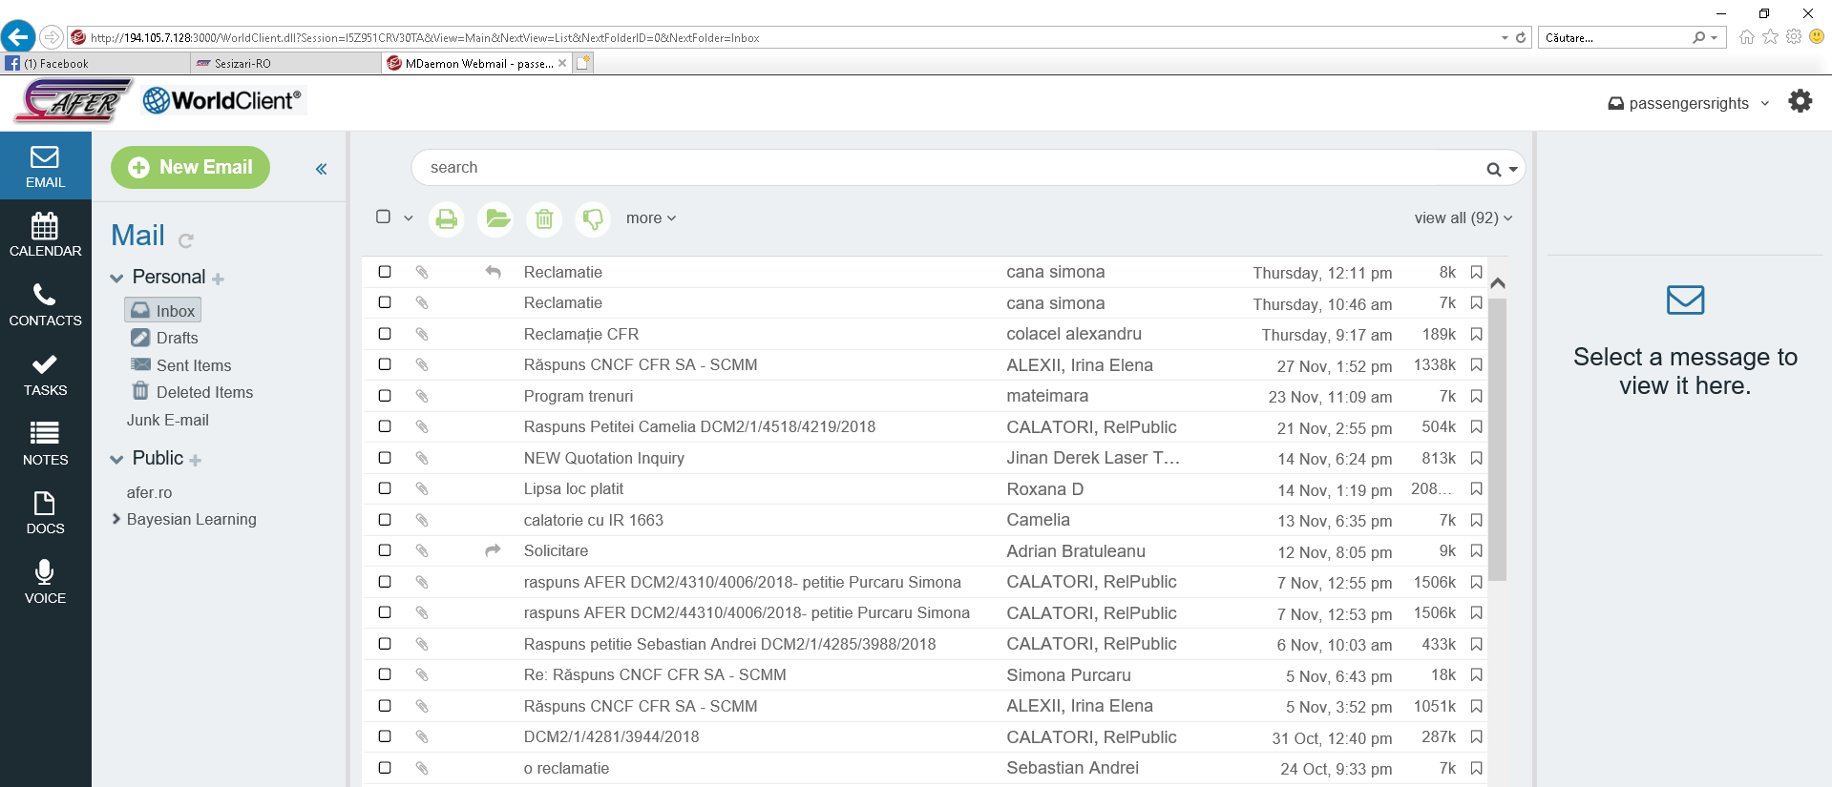
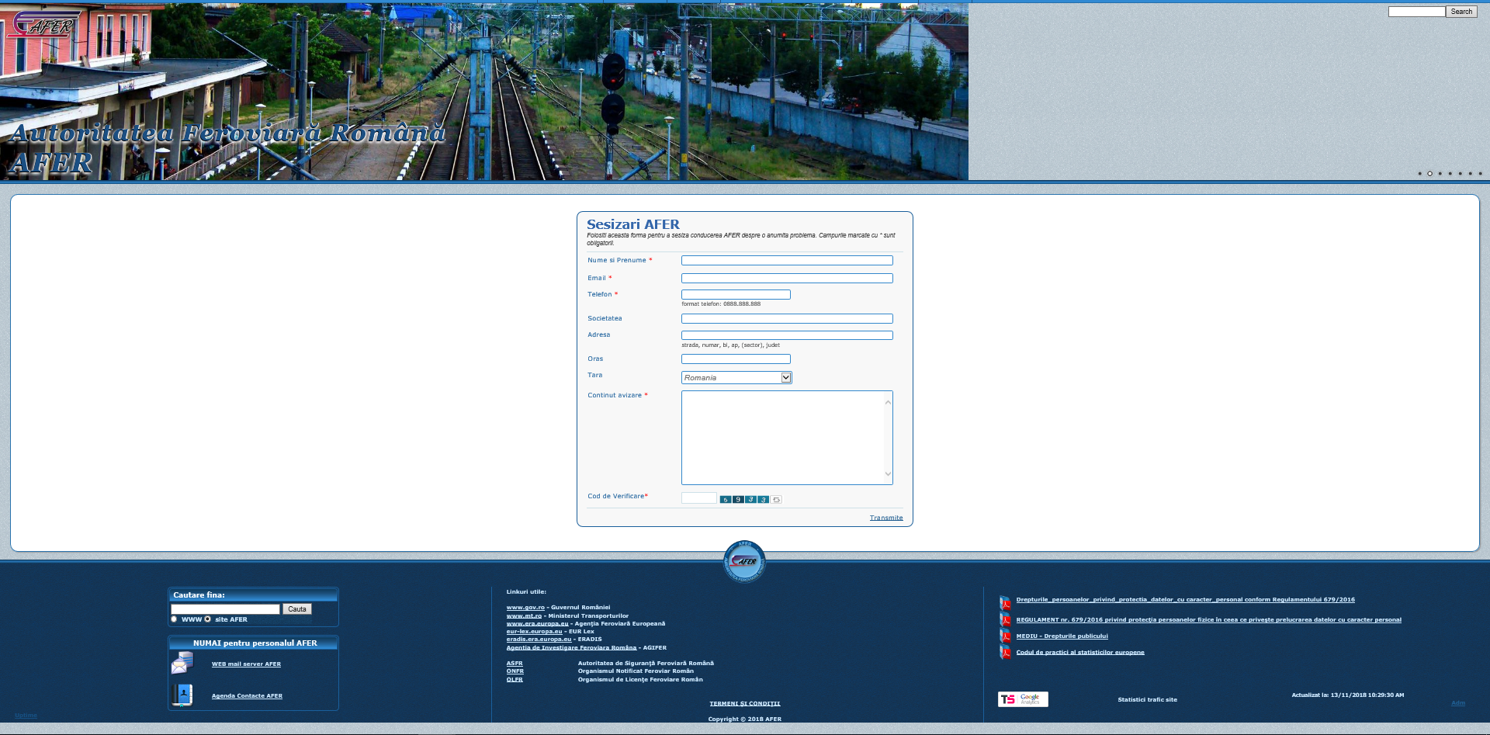
Channels for receiving complaints from passengers or forwarded by other competent institutions
by email address:
passengersrights@afer.ro
by platform www.afer.ro
in the standardized section notifications
by post to the Romanian Railway Authority : București, Calea Griviței nr. 393.
RO NEB -rail pax rights

Slide 16
Complaint handling procedure
Registration complaint
Request a point of view from the entities involved
Receive an answer
Perform on-site research / stakeholders::
views, evaluations / verifications
control, check, inspec
verify, supervise
document verification, records verification
regulatory check
- interviews / questionnaires
oversight operations
- confrontation/comparisons
Preliminary analysis complaint
Request a point of view from the entities involved
or
or
Receive an answer
Intermediate / Final Analysis
In accordance with Law no. 233/2002 (27/2002) on regulation of petitions settlement activity
Develop response
RO NEB -rail pax rights

Slide 17
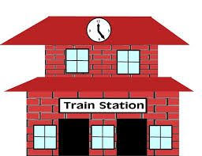
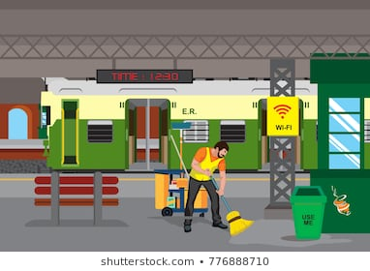
Methods used by NEB
The working methods applied for fulfilling the attributions of the National Enforcement Body designated in Romania are summarized below.
We conduct surveillance actions scheduled for the rail passenger transport operators, the national railway infrastructure manager at least once a year.
In addition, we carry out unscheduled surveillance actions, based on orders received as a result of disfunctionalities occured to the railway passenger transport operators, the national railway infrastructure manager.
These actions are carried out on a random basis in the railway stations, respectively in trains in circulation or in preparing phase, as well as in the central structures of the railway passenger transport operators, of the national railway infrastructure manager.
In order to assess the on-site situation, a series of checklist are developed for the evaluation of trains or separate for stations.
These surveillance actions are concluded with the drawing up of notes containing the findings, respectively the recommendations of the Passengers Rights Surveillance Department from the Romanian Railway Authority – AFER, to which the railway passenger transport operators, the national railway infrastructure manager have to respond with a plan of measures with responsibilities and deadlines for implementation.
Given the existence of the derogations provided for in the REGULATION, which ROMANIA benefits until December 3, 2019, no sanction has been applied until now, but recommendations have been made to which the entities have the obligation to establish their own action plans, in accordance with their own strategies; available resources.
We also carry out the management activity of petitions of the Romanian Railway Authority – AFER.
RO NEB -rail pax rights

Slide 18
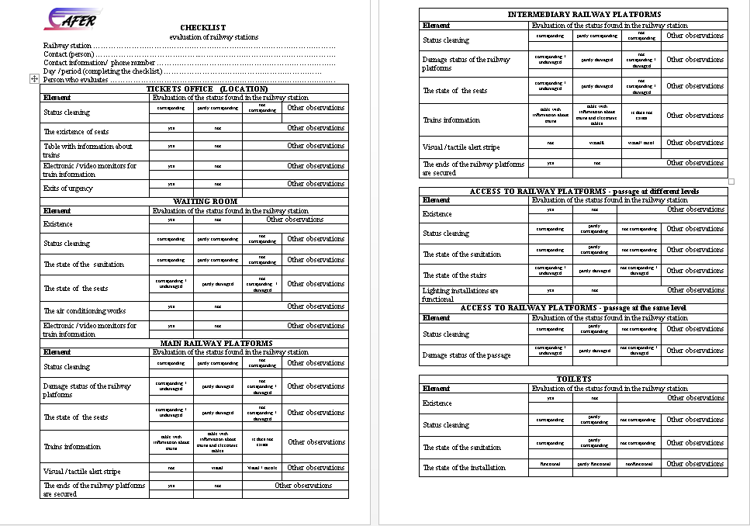
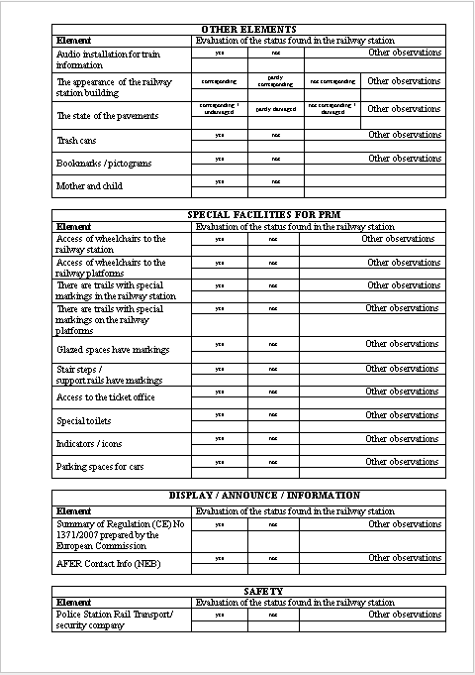
CHECKLIST evaluation of railway stations
RO NEB -rail pax rights

Slide 19
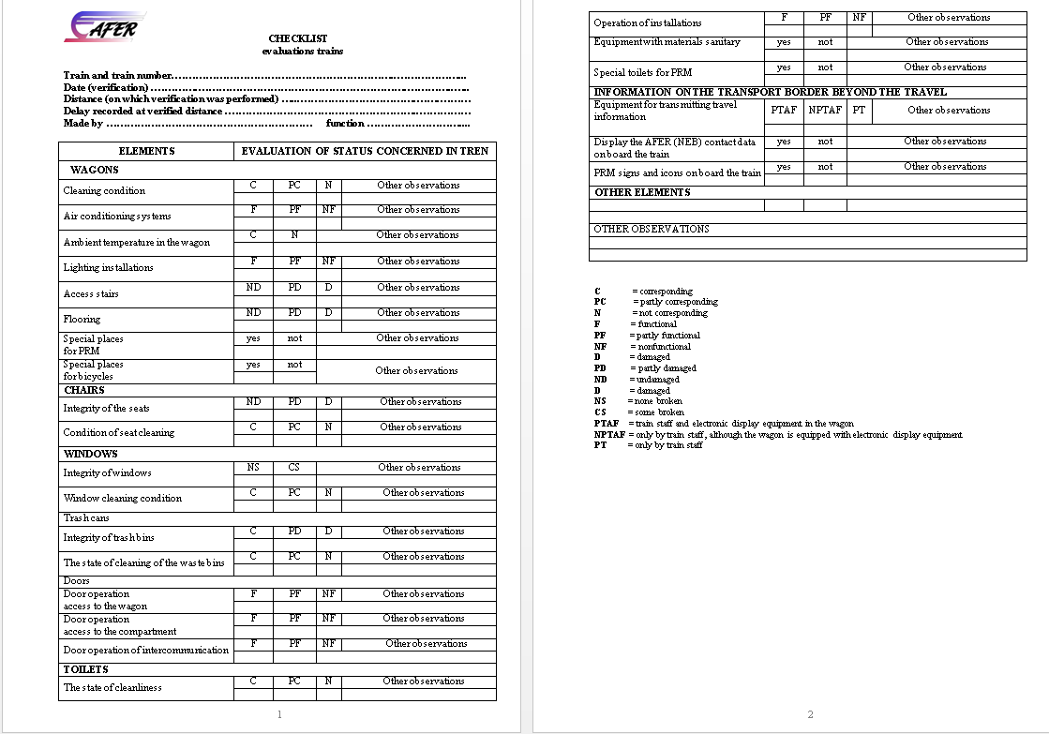
CHECKLIST evaluation of trains
RO NEB -rail pax rights

Slide 20
COMPLIANCE WITH THE REGULATION (EC) 1371/2007
Article 4 - (Exempted Article) - compliance with the Regulation is ensured by the conclusion and performance of the passenger and its own luggage transport contract, as well as the provision of information and tickets. In the case registered luggage, compliance is ensured by some private operators;
Article 5 - (Exempted Article) - compliance with the Regulation is ensured by allowing bicycle access on board trains, even if there are not always specially designated areas for this purpose, provided if this does not adversely affect the specific rail transport service;
Article 6 - (Exempted Article) - compliance with the Regulation is ensured. No concrete cases have been identified;
Article 7 - (Exempted Article) - compliance with the Regulation is ensured;
Article 8 (1) - (Exempted Article) - compliance with the Regulation is ensured;
Article 8 (2) - (Exempted Article) - compliance with the Regulation is ensured only by train staff or partly by other means (audio, video);
Article 8 (3) - (Exempted Article) - compliance with the Regulation is partially ensured;
Article 9 (1) - (Non-Exempted Article) - partially fulfilled, except for tickets of transport services, successively offered by several railway undertakings (direct tickets), which are not ensured in domestic traffic (there are no technical, financial, legislative means, etc., available in Romania, for the issue of direct tickets in domestic traffic for successive journeys performed by several railway operators);
RO NEB -rail pax rights

Slide 21
COMPLIANCE WITH THE REGULATION (EC) 1371/2007
Article 9 (2), 9 (3) and 9 (4) - (Non-Exempted Article) - compliance with the Regulation is ensured;
Article 9 (5) - (Non-Exempted Article) - partially fulfilled, except for small stopping points where passenger traffic is very low and there is no information available;
Article 10 - (Exempted Article) - compliance with the Regulation is ensured by the issuance, as far as available, of transport tickets and reservations through its own electronic ticketing system; the requirements for data/information exchange between internal rail transport operators are not fully covered;
Article 11 - (Non-Exempted Article) - compliance with the Regulation is ensured for travelers and their own luggage. In the case of registered luggage, compliance is ensured only by some private operators;
Article 12 - (Non-Exempted Article) - compliance with the Regulation is ensured;
Article 13 - (Exempted Article) – possible cases are in the jurisdiction of the court;
Article 14 - (Exempted Article) – possible cases are in the jurisdiction of the court
Article 15 - (Exempted Article) – possible cases are in the jurisdiction of the court;
Article 16 - (Exempted Article) - compliance with the Regulation is generally ensured, any cases of misunderstanding are in the jurisdiction of the court;
RO NEB -rail pax rights

Slide 22
COMPLIANCE WITH THE REGULATION (EC) 1371/2007
Article 17 - (Exempted Article) - compliance with the Regulation is ensured in international traffic, any cases of misunderstanding in internal traffic are in the jurisdiction of the court;
Article 18 - (Exempted Article) - there have been extreme cases in which assistance was provided for loss of connection or disruption due to adverse weather conditions;
Article 19 (1) - (Non-Exempted Article) - no Railway Infrastructure Manager has established and apply non-discriminatory access rules for the PRM; all rail transport operators have established and apply non-discriminatory access rules for PRMs;
Article 19 (2) - (Non-Exempted Article) - compliance with the Regulation is ensured;
Article 20 (1) - (Non-Exempted Article) - compliance with the Regulation is ensured;
Article 20 (2) - (Exempted Article) - compliance with the Regulation is ensured;
Article 21 (1) - (Exempted Article) - compliance is ensured if there are facilities according to PRM TSI;
Article 21 (2) - (Exempted Article) - compliance with the Regulation is ensured by the fact that trains in circulation are permanently accompanied by on-board staff;
Article 22 - (Exempted Article) - the Infrastructure Managers doesn‘t provides free assistance for boarding or unboarding on the train;
RO NEB -rail pax rights

Slide 23
COMPLIANCE WITH THE REGULATION (EC) 1371/2007
Article 23 - (Exempted Article) - compliance with the Regulation is ensured by the own staff of rail transport operators on board as well as boarding and unboarding on the train, but only in certain stations, for where it is publicly announced;
Article 24 - (Exempted Article) - Compliance with the Regulation is ensured exclusively by the own staff of the rail transport operators, but only in certain stations, for where it is publicly announced;
Article 25 - (Exempted Article) - possible cases are in the jurisdiction of the court;
Article 26 - (Non-Exempted Article) - compliance with the Regulation is ensured;
Article 27 - (Exempted Article) - compliance with the Regulation is ensured;
Article 28 - (Exempted Article) - neither the railway transport operators has defined such service quality standards, does not assess or publish reports on the European Union Agency for Railways website, but use nationally valid regulations covering some of them;
Article 29 - (Exempted Article) - Rail transport operators and infrastructure manager have used the contact details of the designated body in Romania and the summary of the provisions of this Regulation by making it available to travelers for consultation and information;
Article 30 - (Non-Exempted Article) - compliance with the Regulation is ensured;
RO NEB -rail pax rights

Slide 24
"APPEALS IN COURT" on the enforcement of REGULATION (EC) no. 1371/2007
File no. 2327/200/2016 filed by the Buzau District Court - the applicant, Borsan Vasile (a disabled person, blind), requested the court to order CFR Passengers SA to pay the sum of 90,000 lei, representing the equivalent of the moral damages, because the body integrity and the life of the passenger were endangered by the descent from the train because of the lack of audio information on the location of the platform with respect to the train and the obligation to install the passenger audio information systems on board trains on all train seals.
The file is in the role of the High Court of Cassation and Justice.
File no. 10534/3/2015 filed with the District Court 1 Bucharest - the plaintiffs Stoian Luminiţa and Stoian Ştefan (persons with disabilities) requested the court to order CFR Passengers SA to enter into legality up to a given date and to pay moral damages in the amount of 10 000 lei, considering themselves to be discriminated against because they have not been issued on-line tickets on an equal basis with the other travelers and they have not been provided with travel conditions according to REGULATION (EC) no. 1371/2007 and PRM TSI.
File no. 878/P/2014 filed in the Prosecutor's Office attached to the Haţeg District Court - the applicant Nicolae Joița was seriously injured on 13 / 14.09.2014, at CFR Subcetate station between the railway line 3 and 4 (without the platform), by the gasket the IR1823 train, while she was waiting for it to line 4.
The file is in the Haţeg Court.
RO NEB -rail pax rights

Slide 25
Q and A
1. Regarding the quality of rail passengers
The Regulation does not define how the traveler can be proven to be in railway transport and whether the rights in the Regulation only benefit travel-card holders.
How can the provisions of the REGULATION apply to:
a person arriving at the ticket office to be informed about the train journey and for various reasons does not acquire a travel card, but complains that he has not been provided with information on the link to another train served by another railway undertaking or referees under certain general conditions of carriage prescribed in the REGULATION (anticipation, interruption, pet on board, etc.)?
to a person who is not a traveler but awaits the arrival of a traveler and lodges a complaint claiming that he has requested and received no information regarding the delay of the train or the interruption of the railway service or injured in the railway station?
the refusal of a railway undertaking to respond to a complaint relating to the movement of a train by a person who does not provide evidence of possession of a travel card?
Can those people be denied the right because they can not prove possession of a travel card?
2. Concerning the verification of tour operators
How can the NEB verify the compliance of the tour operators REGULATION (Article 8, Article 9, Article 10, Article 20, Article 24), provided that these entities operate under the different authorities, respectively under the authority of the Ministry of Tourism, not the Ministry of Transport? How is it in other countries?
3. Concerning the stipulation of the limits provided in art.6 (1):
"Obligations to passengers under this Regulation may not be limited or waived, in particular by way of derogation or restrictive clause contained in the contract of carriage."
NEB has not identified such limitations. For clarification, can you give us some examples of limiting our obligations to passengers?
RO NEB -rail pax rights

Slide 26
Q and A
4. Regarding the availability of direct tickets (art.10)
"Railway undertakings and ticket vendors offer tickets, direct tickets and reservations, subject to availability."
Does the availability syntax provided for in Article 10 of the RULE only refer to the availability of seats for reservation or to the practical availability of direct tickets?
There are no technical, financial, legislative, etc. available in Romania the issue of direct tickets in domestic traffic for successive journeys performed by several railway operators, and railway operators can not be compelled to comply with the requirement of the REGULATION. In this case what can NEB do?
5. Regarding the methods used by NEB
In addition to sanctions and recommendations (if there are any exceptions at REGULATION), what other methods can use the NEB for non-conformities identified during supervisory follow-up or investigation of complaints? In other countries how do NEBs work? Can NEB develop guidelines that are applicable at national level? Is there such regulation in other countries and if so, where?
6. Regarding the ex officio seizure of the NEB.
How it is regulated in other countries the NEB's ex officio referral to cases of violations of travelers' rights reported in the press ?
7. Regarding quality standards (art. 28).
The obligation to define quality standards rests with railway undertakings under Article 28 of the REGULATION.
In practice. How the rest of the country do?
What is your recommendation?
does the NEB establish a list of quality standards based on regulations in force and impose it on railway undertakings?
do railway undertakings establish their own standards? - where there may be major differences between them and the NEB evaluation will also be differentiated.
or a combination of the two?
RO NEB -rail pax rights

Slide 27
thank you for your attention
RO NEB -rail pax rights

